Slide 1

Computer Engineering Department
A.P. Shah Institute of Technology
G.B.Road,Kasarvadavli, Thane(W), Mumbai-400615
UNIVERSITY OF MUMBAI
Academic Year 2019-2020

Slide 2
A Project Report on
Digital Image Processing Solutions for Offside Recognition in Football
Submitted in partial fulfillment of the degree of
Bachelor of Engineering(Sem-7)
in
Computer Engineering
By
Pradipt Kalamkar(moodle Id)
Ketan Wadekar(moodle Id)
Vatsal Panchal(moodle Id)
Under the Guidance of
Prof. Krupi Saraf

Slide 3
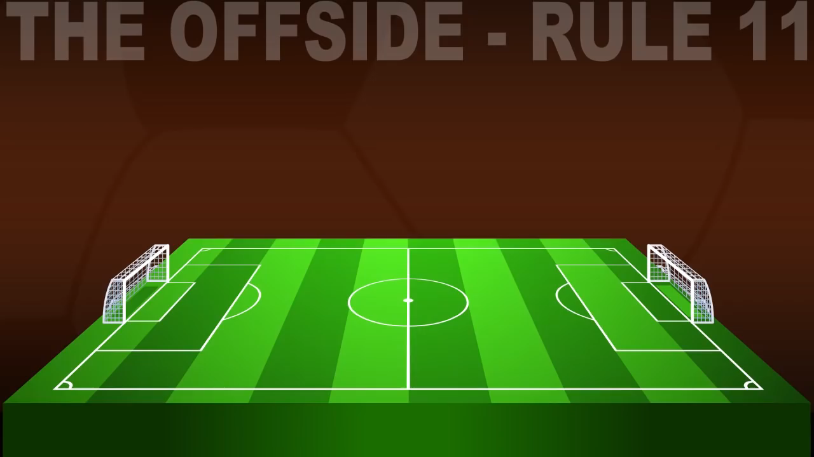

1.Project Conception and Initiation
-What is
Offside
in
Football ?

Slide 4
1.1 Abstract
A solution for declaration of office event in soccer game based on digital image are Installed at stadium that send video pictures to a central processor system.
Based on image processing methods the ball, Players and referees group are specified by object’s morphological properties.
The other important topic in this paper is the way that how the system can realize the correct estimation of player’s location and ball by analyzing the video cam pictures in crowded areas.
To solve this problem, numeral computation and optical physics formulas are used to calculate the real coordinates of objects at soccer field.
There are a lot of prepared library methods to specify objects. Recognition players, ball and referees in the crowded pictures need to override modules. But firstly we need to get real coordinate’s location from visible pixels of each objects.

Slide 5
1.2 Objectives
To Detect the offside case in a Match immediately as it occurs to cut that rest period of a few minutes.
To maintain the tempo of the game is one of the main objectives of this project.
This system can be used at the highest of the levels as the FIFA World Cup as well as the biggest of the European Championships such as the UEFA Champions League. Making use of the system makes more sense in the higher levels as the stakes are high and one small incorrect decision such as an offside one may shift the whole momentum of the matches.

Slide 6
1.3 Literature Review
Researchers have done a lot of research to develop the idea of evaluating players’ position on the football field and getting a way to find out the events occurred in the field. Guoying Jin et al. have presented a video processing model called Hidden Markov Model to detect every event of a football match like offside. An experiment was done to find out the result and their method worked correctly as the model can find any event effectively. Their experiment worked perfectly as the games have primitive patterns like shoot, heading, jump etc. (Jin, 2004).
Tracking any object from the data given from the camera is also challenging. P. Mazzeo et al. have done an excellent work to classify players in multiple camera environments. They have used an unsupervised algorithm to generate class models of objects from different cameras. They also used a cumulative brightness transfer function to classify same colored objects like players in the same team or referees and they found a good result (Mazzeo, 2010). S. de Sousa et al. also have done a good research to detect an offside during the match.

Slide 7
1.3 Literature Review
This idea can also be used for tracking the players as players have less speed than a football. As their experiment worked correctly, it can be used to track the players on the field. The shadow is one of the most complex barriers to track players especially when a game occurs at night. J. Renno et al. have done a research to classify shadow to detect players perfectly. They used unsupervised learning procedure to get RGB from the images to distinguish the foreground and shadow.

Slide 8
1.4 Problem Definition
To increase the precision of the onside decision a system has been aimed that is called Tracking Technology in where quantify players positions and runs an algorithm to detect which players are onside or not.
To develop a system that recognises offside in a live soccer game by analysing the live stream or videos captured during the game by using digital video processing

Slide 9
1.5 Scope
The football matches have high value in the sports market and make a significant impact to an economy of a country.
Offside is an important rule for making fair competition for offence and defence to fight for getting and protecting the goal
However since linesman sometimes cannot see important scenes for suggesting judgement to the referee due to limitation of the seeing ability of human, Afterimage, occlusion, and so on, the automatic system of linesman for detecting offside is urgently required.
To maintain the tempo of the game is one of the major aims of this project.

Slide 10
1.6 Technology stack
Dataset – Video clips from Football matches
IDE : Google Collab/Jupyter notebook
Programming language : PYTHON
Libraries : OpenCV, Tensorflow

Slide 11
1.7 Benefits for Environment and Society
This system can be used by the International Federation of Association Football (FIFA) and the Union of European Football Associations (UEFA) for instant decisions in tight offside situations. This system can be used at the highest of the levels as the FIFA World Cup as well as the biggest of the European Championships such as the UEFA Champions League. Making use of the system makes more sense in the higher levels as the stakes are high and one small incorrect decision such as an offside one may shift the whole momentum of the matches.

Slide 12
2. Project Design

Slide 13
2.1 Proposed System

Slide 14
2.1 Proposed System

Slide 15
2.1 Proposed System
When the captured film of an object consists of soccer players and ball is shown in the central system, It is necessary to get coordinate’s abscissa and breadth of objects. On television during a soccer game a line parallel to breadth line of playground as offside line is seen and they spot the intersection of this line and abscissa line, abscissa location(X) of players or ball. This small mistake causes large mistakes in analysis of soccer umpire.
Below shown are the steps of the algorithm .i.e. the flow of the algorithm. This diagram is the whole framework to detect offside

Slide 16
2.1 Proposed System

Slide 17
2.2 Design(Flow Of Modules)
Capturing image from Video
Detecting the Ball
Detecting the players
Making imaginary offside line
Making offside decision and giving the output

Slide 18
2.2 Design(Flow Of Modules)
Capturing image from video: In order to track an offside successfully my proposed system uses two fixed cameras in behind the both sides of goal post that will give a flag whether the ball is in the contact with a player or not. That means both side cameras will give a false value when players touch the ball because there is no chance of occurring offside when the player touches the ball. The cameras will give a true value when no one touches the ball because there is a good chance of occurring offside event when the player releases the ball to another player. The both side cameras also give a timestamp when the value goes from false to true. On the other hand, six cameras will be on the top of the field perpendicularly on the both side of the field which will capture the image of the field. They will capture the image at the given timestamp that means when both side cameras give value from false to true six cameras will capture the whole field condition.

Slide 19
2.2 Design(Flow Of Modules)
Detecting the ball: The ball is the main part of a match and detecting a ball from the captured image is also a hard task as the size of the ball is relatively small and its pattern sometimes matches with the field pattern. An algorithm named top hat is used to detect the ball. It is actually subtraction process and with this process, the non-ball part is deleted from the image
Detecting the players: An event like offside detection goes much complex because of lack of player detection and it is the key part of detecting this event. The image data is analysed based on the image processing more specifically via color detection. Color is first normalized with the help of normalized RGB method. RGB (Red, Green and Blue) value is divided by the sum of all the value and it gets more readable on each pixel.

Slide 20
2.2 Design(Flow Of Modules)
Making imaginary offside line: This line is made based on the last player’s position of the opposition team and this line is moving dynamically as players are moving. This imaginary line is created on the both side of the field for both teams from the images taken from the perpendicular cameras.
Making offside decision and giving the output: This part checks which coloured player releases the ball and find which players crossed the offside line having the same colour because there is a chance of occurring an offside event. So if the players who already crossed the imaginary line gets the ball the offside will be detected and output will be a true value. Otherwise if other player gets the ball who has not crossed the line, offside will not occur and the output will be a false value. The data will be collected from two types of cameras as images with a timestamp which makes the difference from one frame to another frame.

Slide 21
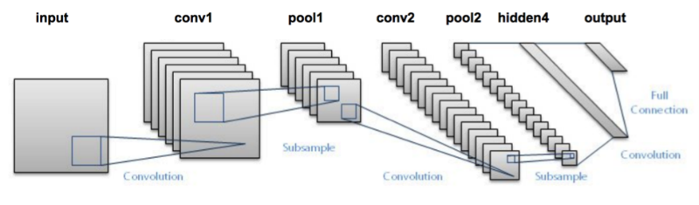
2.3 Object Detection Task (using Deep Learning)
Algorithm used : Convolutional Neural Networks (CNN)

Slide 22
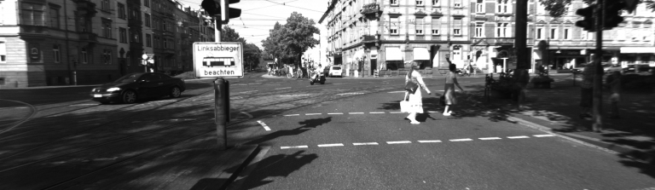
2.3 Object Detection Task (using Deep Learning)
We pass an image to the network, and it is then sent through various convolutions and pooling layers. Finally, we get the output in the form of the object’s class. Fairly straightforward, isn’t it?
For each input image, we get a corresponding class as an output. Can we use this technique to detect various objects in an image? Yes, we can! Let’s look at how we can solve a general object detection problem using a CNN.
First, we take an image as input:

Slide 23
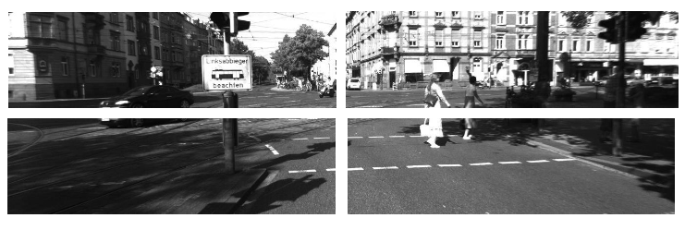
2.3 Object Detection Task (using Deep Learning)
2. Then we divide the image into various regions:

Slide 24
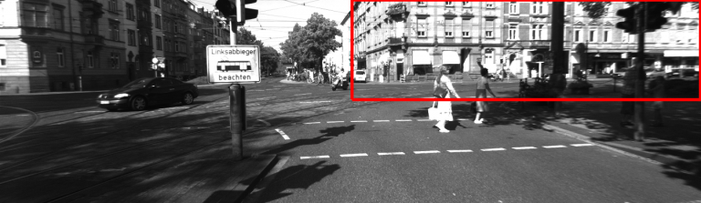
2.3 Object Detection Task (using Deep Learning)
3. We will then consider each region as a separate image. 4. Pass all these regions (images) to the CNN and classify them into various classes. 5. Once we have divided each region into its corresponding class, we can combine all these regions to get the original image with the detected objects:

Slide 25
2.3 Object Detection Task (using Deep Learning)
The problem with using this approach is that the objects in the image can have different aspect ratios and spatial locations. For instance, in some cases the object might be covering most of the image, while in others the object might only be covering a small percentage of the image. The shapes of the objects might also be different (happens a lot in real-life use cases).
As a result of these factors, we would require a very large number of regions resulting in a huge amount of computational time. So to solve this problem and reduce the number of regions, we can use region-based CNN, which selects the regions using a proposal method.

Slide 26
2.3 Understanding Region-Based Convolutional Neural Network
Instead of working on a massive number of regions, the RCNN algorithm proposes a bunch of boxes in the image and checks if any of these boxes contain any object. RCNN uses selective search to extract these boxes from an image (these boxes are called regions).
Let’s first understand what selective search is and how it identifies the different regions. There are basically four regions that form an object: varying scales, colors, textures, and enclosure. Selective search identifies these patterns in the image and based on that, proposes various regions. Here is a brief overview of how selective search works:

Slide 27
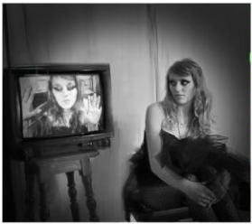

It first takes an image as input:
Then, it generates initial sub-segmentations so that we have multiple regions from this image:

Slide 28
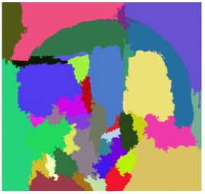
The technique then combines the similar regions to form a larger region (based on color similarity, texture similarity, size similarity, and shape compatibility):

Slide 29
Below is a short summary of the steps followed in RCNN to detect objects:
We first take a pre-trained convolutional neural network.
Then, this model is retrained. We train the last layer of the network based on the number of classes that need to be detected.
The third step is to get the Region of Interest for each image. We then reshape all these regions so that they can match the CNN input size.
After getting the regions, we train SVM to classify objects and background. For each class, we train one binary SVM.
Finally, we train a linear regression model to generate tighter bounding boxes for each identified object in the image.

Slide 30
2.7 References
Tiziana D'Orazio ; Marco Leo ; Paolo Spagnolo ; Pier Luigi Mazzeo ; An Investigation Into the Feasibility of Real-Time Soccer Offside Detection From a Multiple Camera System; https://ieeexplore.ieee.org/document/5159423/
[1]. Jin, G., Tao, L., & Xu, G. (2004). Hidden Markov Model Based Events Detection in Soccer Video. Lecture Notes in Computer Science, 605-612. http://dx.doi.org/10.1007/978-3-540-30125-7_75
[2]. Mazzeo, P., Spagnolo, P., Leo, M., & D’Orazio, T. (2010). Football Players Classification in a Multi-camera Environment. Advanced Concepts For Intelligent Vision Systems, 143-154. http://dx.doi.org/10.1007/978-3-642-17691-3_14
[3]. Renno, J., Orwell, J., Thirde, D., & Jones, G. (2004). Shadow Classification and Evaluation for Soccer Player Detection. Procedings of the British Machine Vision Conference 2004. http://dx.doi.org/10.5244/c.18.86
Sirimamayvadee Siratanita ; Kosin Chamnongthai ; Mistusji Muneyasu; Saliency-based football offside detection; https://ieeexplore.ieee.org/document/8261213/
Sirimamayvadee Siratanita ; Kosin Chamnongthai ; Mistusji Muneyasu; A method of saliency-based football-offside detection using six cameras; https://ieeexplore.ieee.org/document/8300486/
An Investigation into the Feasibility of Real-time Soccer Offside Detection from a Multiple Camera System T. D’Orazio (Member IEEE), M. Leo, P. Spagnolo, P. L. Mazzeo, N. Mosca, M. Nitti, A. Distantehttp://people.isasi.cnr.it/~m.leo/pubblica/Paper_IEEE_final_2009.pdf

Slide 31
3.Planning for next semester

Slide 32
Planning
We have currently focusing on Module 1 and Module 2 namely Detection of the Ball and Detection of Players and that is the most important part of the project. The remaining modules such as Making of the offside line and giving the offside decision is planned to be completed in the upcoming semester.

Slide 33
Thank You

